Slide 1
Simplified AES
Dr. Sara Qaisar

Slide 2
AES using Hexa-Decimal to Binary

Slide 3
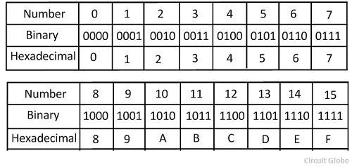
AES Simplified
Plain Text : 6F 6B
HexaDecimal to Binary Values
0110 1111 0110 1011
Key: A7 3B
HexaDecimal to Binary Values
1010 0111 0011 1011

Slide 4
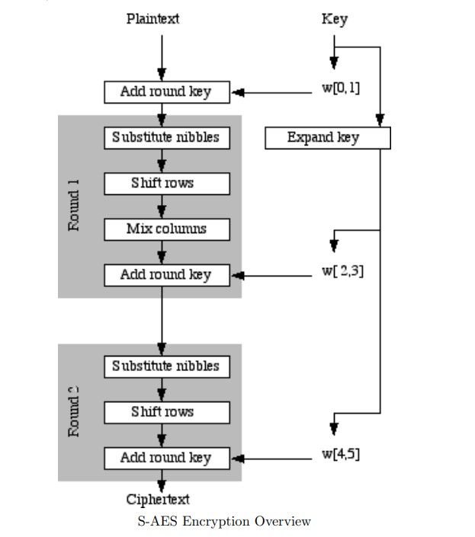

Slide 5
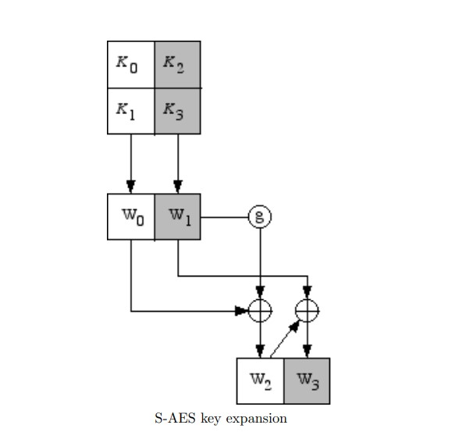
AES Key Expansion

Slide 6
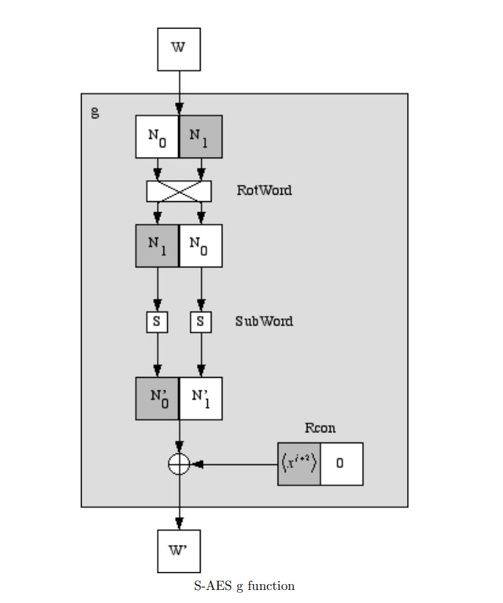

Slide 7
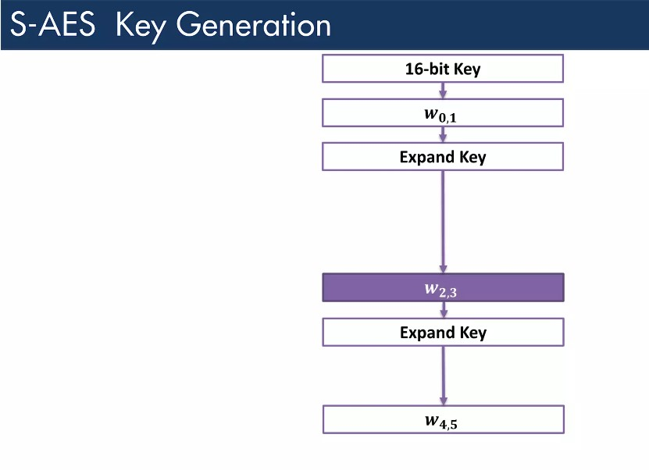
Key Expansion

Slide 8
Key: A7 3B
HexaDecimal to Binary Values
1010 0111 0011 1011
Key divided into two parts
W0= 1010 0111
W1= 0011 1011

Slide 9
RCJ for round one and two are 1000 and 0011 respectively
W2= DE (1101 1110)
W3=35 (0011 0101)
Whereas
w2= w0 ⊕ Rcon(1) ⊕ SubNib(RotNib(w1))
w3= w2⊕w1
w4= w2 ⊕ Rcon(2) ⊕ SubNib(RotNib(w3))
w5= w3⊕w4

Slide 10
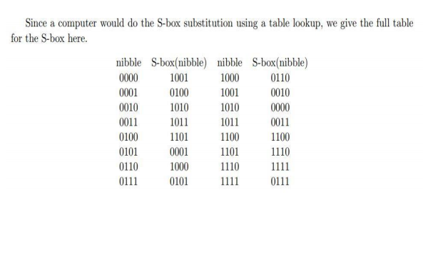
w2= w0 ⊕ Rcon(1) ⊕ SubNib(RotNib(w1))
= 1010 0111 ⊕ 1000 0000 ⊕ subNib(1011 0011)
=1010 0111 ⊕ 1000 0000 ⊕ 0011 1011
=1010 0111 ⊕ 1011 1011
= 0001 1100
w3= w2⊕w1
= 0001 1100 ⊕ 0011 1011
= 0010 0111
w4= w2 ⊕ Rcon(2) ⊕ SubNib(RotNib(w3))
= 0001 1100 ⊕ 0011 0000 ⊕ SubNib(0010 1011)
= 0001 1100 ⊕ 0011 0000 ⊕ 1010 0011
= 0001 1100 ⊕ 1001 0011
= 1000 1111
w5= w3⊕w4
= 0010 0111 ⊕ 1000 1111
= 1010 1000

Slide 11
Key0=w0w1
= 1010 0111 0011 1011
Key1=w2w3
=0001 1100 0010 0111
Key2=w4w5
= 1000 1111 1010 1000

Slide 12
Encryption
Plain Text : 6F 6B
HexaDecimal to Binary Values
0110 1111 0110 1011
Key: A7 3B
HexaDecimal to Binary Values
1010 0111 0011 1011
First Step:
P: 0110 1111 0110 1011
K: 1010 0111 0011 1011
----------------------------------
1100 1000 0101 0000
⊕

Slide 13
Substitution Box
Second Step: Substitution Box
=
Third Step: Shift Rows
1100 | 1000
0101 | 0000
1100 | 0110
0001 | 1001
1100 | 0110
1001 | 0001

Slide 14

Fourth step is shift Column
⊕ $\left[\begin{matrix}1 & 4 \\ 4 & 1\end{matrix}\right]$
= $\left[\begin{matrix}1 & x2 \\ x2 & 1\end{matrix}\right]$
Equations are :
1100*1 ⊕ (4 * 0110)
(4 * 1100) ⊕ 0110 *1
1001*1 ⊕ (4 * 0001)
(4 * 1001) ⊕ 0001 *1
1100 | 0110
1001 | 0001

Slide 15
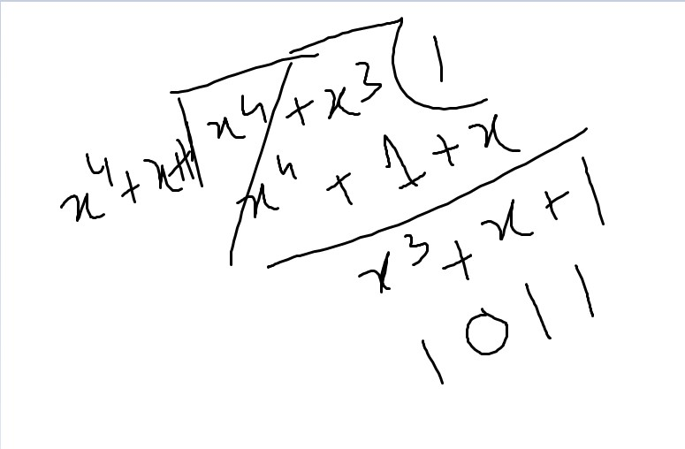
Shift Column
1100*1 ⊕ (4 * 0110)
=(x2 * x2+x)
= (x4+ x3) (reducible to x4+x+1)
1100*1 ⊕ (4 * 0110)
1100 ⊕ 1011
0111
0111

Slide 16
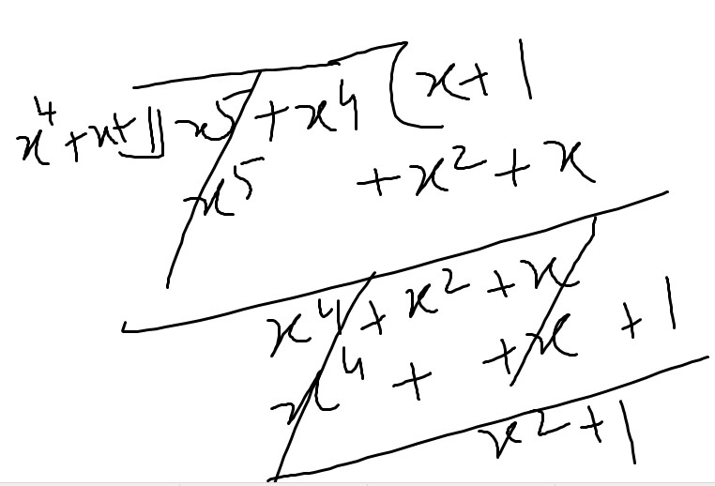
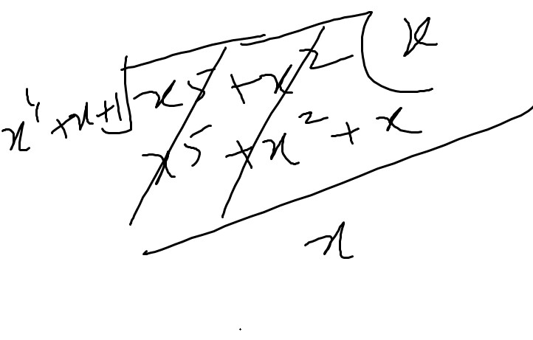
(4 * 1100) ⊕ 0110 *1
(x2* x3+x2) ⊕ 0110 *1
x5+x4 ⊕ 0110
0101 ⊕ 0110
0011
1001*1 ⊕ (4 * 0001)
1001*1 ⊕ (x2 * 1)
1001 ⊕ 0100
1101
(4 * 1001) ⊕ 0001 *1
(x2 * x3+1) ⊕ 0001
x5+x2 ⊕ 0001
0010 ⊕ 0001
0011
0111 | 0011
1101 | 0011

Slide 17
Fifth Step: Add round key
Key1 = 0001 1100 0010 0111
P =0111 0011 1101 0011
-------------------------------------------
CIPHER TEXT = 0110 1111 1111 0100
⊕

Slide 18
Thanks

